Slide 2
Hierarchical cognitive modeling
department < ... >
research group < ... >
And model comparisons

Slide 3

Focus?

Slide 4
Contents
Model specification
Model estimation
Maximum Likelihood
Bayesian
Model comparison
Fixed effects
Mixed effects
The Hierarchical Interdependence Problem
Both can be Hierarchical?

Slide 5

Model specification

Slide 6

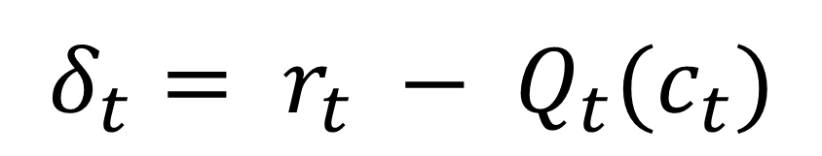
Examples from RL
Model-Free RL (Q-learning)
$$Q_{t+1}\left(c_{t}\right)=Q_{t}\left(c_{t}\right)+α∙δ_{t}$$
$$δ_{t}= r_{t} − Q_{t}(c_{t})$$
Daw (2009)

Slide 7
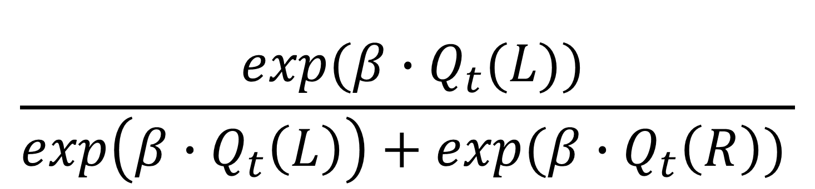

Choices
Softmax function
$$P\left(c_{t}=L|Q_{t}\left(L\right),Q_{t}(R)\right)$$
$$\frac{⁡exp(β∙Q_{t}(L))}{\exp\left(β∙Q_{t}\left(L\right)\right)+exp⁡(β∙Q_{t}\left(R\right))⁡}$$

Slide 8

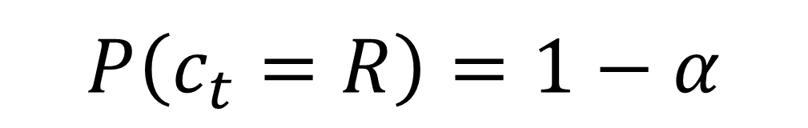
Competing models
Dual learning rate
Frank et al. (2007)
$$Q_{t+1}\left(c_{t}\right)= Q_{t}\left(c_{t}\right)+ a_{G}[δ_{t}]_{+} +a_{L}[δ_{t}]_{−}$$
Fixed Bias
$$P\left(c_{t}=L\right)= α$$
$$P\left(c_{t}=R\right)=1−α$$

Slide 9
Parameters to estimate
Model Free Q-Learning
Model:
Learning Rate: α
Softmax / Logistic Regression:
Inverse Temperature: β
Dual Learning Rates
Model:
Learning Rate Gain: α_{G}
Learning Rate Loss: α_{L}
Softmax / Logistic Regression:
Inverse Temperature: β
Fixed Bias
Model:
Bias: α
x2
x3
x1

Slide 10
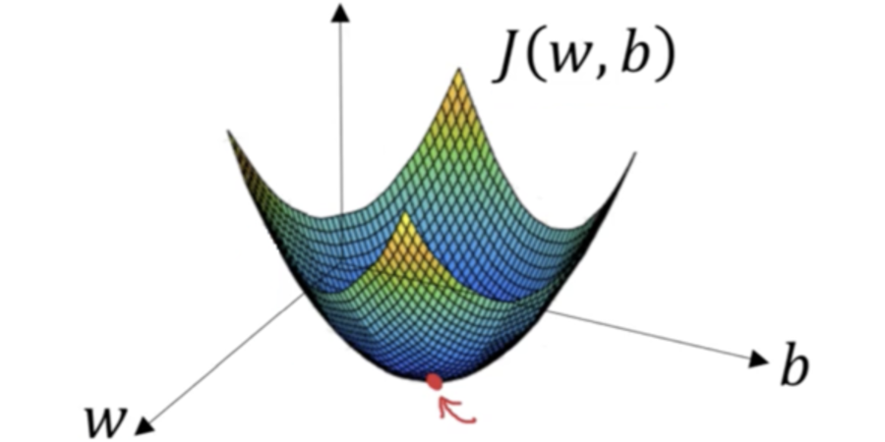
Model Estimation

Slide 11
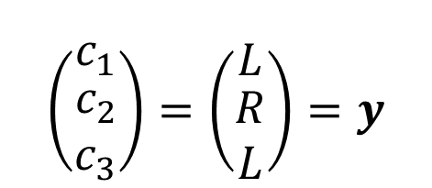
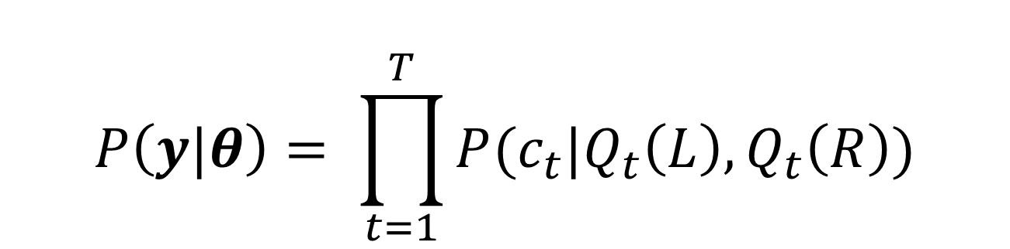
Maximum likelihood
$$\left(\begin{matrix}c_{1} \\ \begin{aligned}c_{2} \\ c_{3}\end{aligned}\end{matrix}\right)=\left(\begin{matrix}L \\ \begin{aligned}R \\ L\end{aligned}\end{matrix}\right)=y$$
$$P\left(y\right)=P\left(c_{1},c_{2},c_{3}\right)=P(c_{1})∙P(c_{2})∙P(c_{3})$$
$$P\left(y|θ\right)= \prod_{t=1}^{T}{P(c_{t}|Q_{t}\left(L\right),Q_{t}\left(R\right))}$$
‘Given theta’

Slide 12
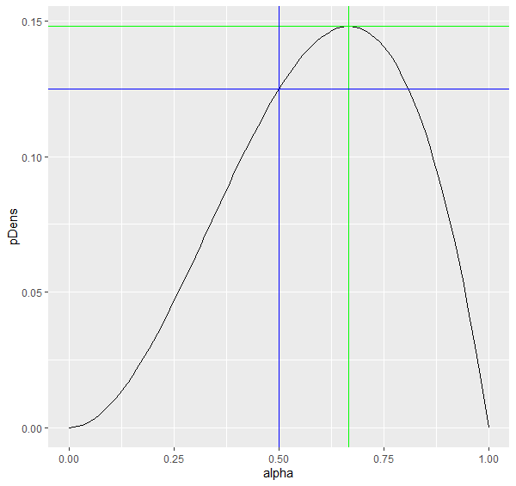
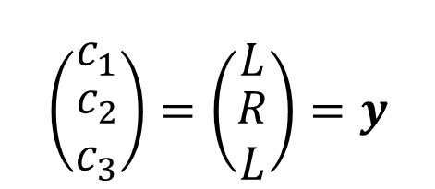
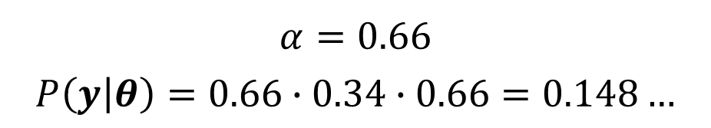

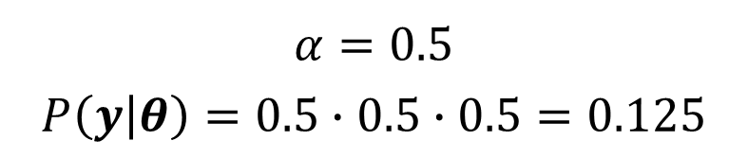

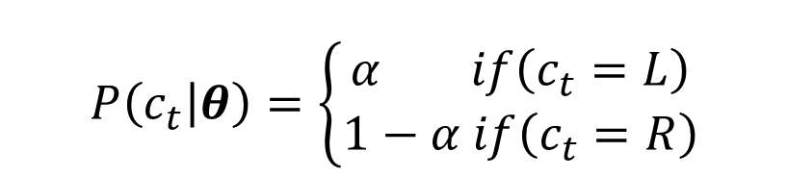
ML Example
Fixed Bias
$$θ=\{α\}$$
$$\left(\begin{matrix}c_{1} \\ \begin{aligned}c_{2} \\ c_{3}\end{aligned}\end{matrix}\right)=\left(\begin{matrix}L \\ \begin{aligned}R \\ L\end{aligned}\end{matrix}\right)=y$$
$$P\left(c_{t} | θ\right)=\left\{\begin{aligned}α if\left(c_{t}=L\right) \\ 1−α if\left(c_{t}=R\right)\end{aligned}\right.$$
$$P\left(y | θ\right)= α∙(1−α)∙α$$
$$α=0.5$$
$$P\left(y | θ\right)=0.5∙0.5∙0.5=0.125$$
$$α=0.66$$
$$P\left(y | θ\right)=0.66∙0.34∙0.66=0.148…$$

Slide 13




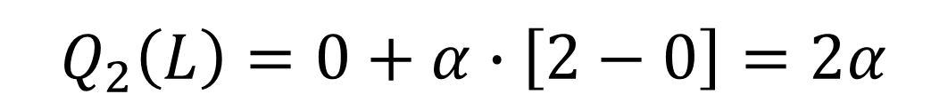

ML Example
Model Free Q-Learning
$$\left(\begin{matrix}c_{1} \\ \begin{aligned}c_{2} \\ c_{3}\end{aligned}\end{matrix}\right)=\left(\begin{matrix}L \\ \begin{aligned}L \\ R\end{aligned}\end{matrix}\right)=y$$
$$Q_{2}\left(L\right)=0+α∙\left[2−0\right]=2α$$
 | Q(L) | Q(R)
t = 1 | 0 | 0
t = 2
t = 3
$$Q_{3}(L)=2α+α∙\left[1−2α\right]=α(3−2α)$$
$$r=\left(\begin{matrix}2 \\ \begin{aligned}1 \\ 1\end{aligned}\end{matrix}\right)$$
2$α$
0
$$0$$
$α(3−2α$)
$Q_{t+1}\left(c_{t}\right)=Q_{t}\left(c_{t}\right)+α∙[r_{t}−$ $Q_{t}\left(c_{t}\right)]$

Slide 14
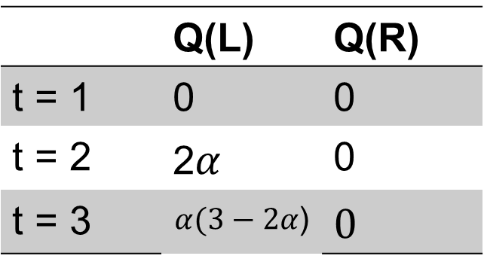


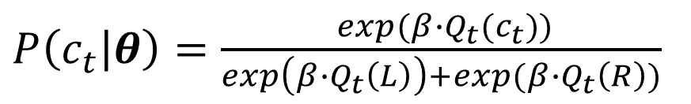

ML Example
Model Free Q-Learning
$$\left(\begin{matrix}c_{1} \\ \begin{aligned}c_{2} \\ c_{3}\end{aligned}\end{matrix}\right)=\left(\begin{matrix}L \\ \begin{aligned}L \\ R\end{aligned}\end{matrix}\right)=y$$
$$θ=\{α,β\}$$
 | Q(L) | Q(R)
t = 1 | 0 | 0
t = 2 | 2$α$ | 0
t = 3 | $$α(3−2α\text{)}$$ | $$0$$
$P\left(c_{t} | θ\right)=$ $\frac{⁡exp(β∙Q_{t}(c_{t}))}{\exp\left(β∙Q_{t}\left(L\right)\right)+exp⁡(β∙Q_{t}\left(R\right))⁡}$
$$α=0.8$$

Slide 15
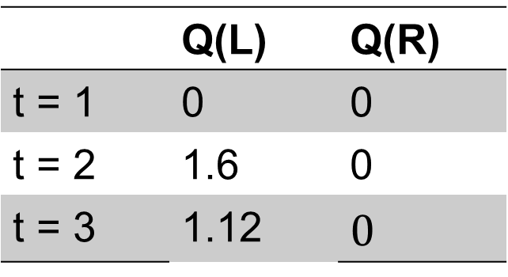

ML Example
Model Free Q-Learning
$$\left(\begin{matrix}c_{1} \\ \begin{aligned}c_{2} \\ c_{3}\end{aligned}\end{matrix}\right)=\left(\begin{matrix}L \\ \begin{aligned}L \\ R\end{aligned}\end{matrix}\right)=y$$
$$θ=\{α,β\}$$
 | Q(L) | Q(R)
t = 1 | 0 | 0
t = 2 | 1.6 | 0
t = 3 | 1.12 | $$0$$
$P\left(c_{t} | θ\right)=$ $\frac{⁡exp(β∙Q_{t}(c_{t}))}{\exp\left(β∙Q_{t}\left(L\right)\right)+exp⁡(β∙Q_{t}\left(R\right))⁡}$
$$α=0.8$$
$$β=0.4$$

Slide 16
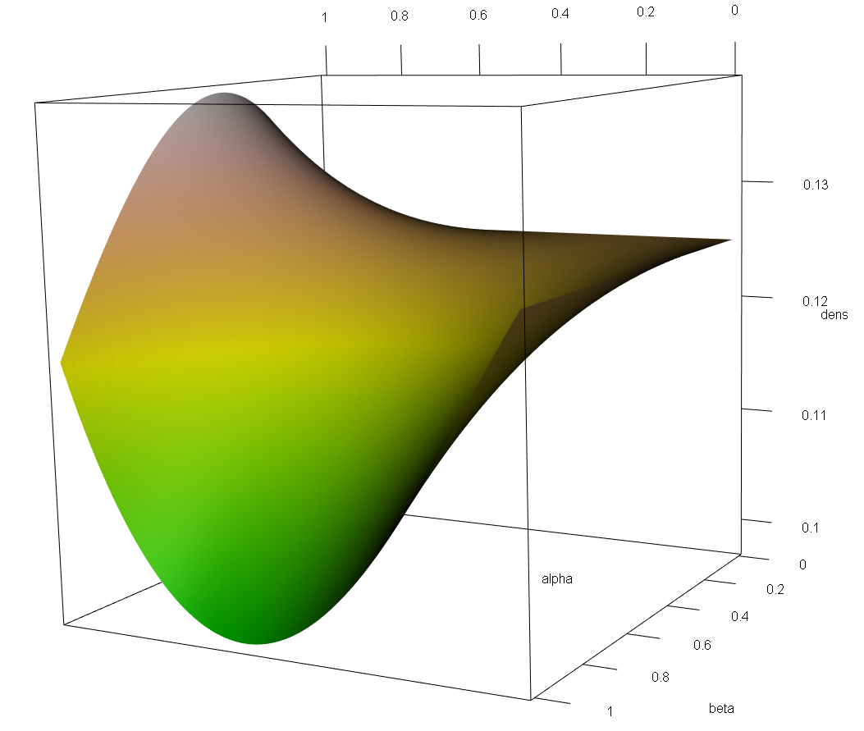
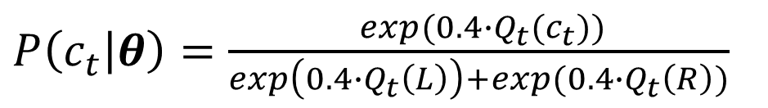
ML Example
Model Free Q-Learning
$$\left(\begin{matrix}c_{1} \\ \begin{aligned}c_{2} \\ c_{3}\end{aligned}\end{matrix}\right)=\left(\begin{matrix}L \\ \begin{aligned}L \\ R\end{aligned}\end{matrix}\right)=y$$
$$θ=\{α,β\}$$
 | Q(L) | Q(R)
t = 1 | 0 | 0
t = 2 | 1.6 | 0
t = 3 | 1.12 | $$0$$
$P\left(c_{t} | θ\right)=$ $\frac{⁡exp(0.4∙Q_{t}(c_{t}))}{\exp\left(0.4∙Q_{t}\left(L\right)\right)+exp⁡(0.4∙Q_{t}\left(R\right))⁡}$
$$α=0.8$$
$$P\left(y|θ\right)=P\left(c_{1},c_{2},c_{3}|θ\right)=P(c_{1}|θ)∙P(c_{2}|θ)∙P(c_{3}|θ)$$
$$β=0.4$$
$P\left(y | θ\right)=\frac{exp⁡(0.4∙0)}{\exp\left(0.4∙0\right)+exp⁡(0.4∙0)}∙$ $\frac{exp⁡(0.4∙1.6)}{\exp\left(0.4∙1.6\right)+exp⁡(0.4∙0)}$ $∙$ $\frac{exp⁡(0.4∙0)}{\exp\left(0.4∙1.12\right)+exp⁡(0.4∙0)}≈0.1$

Slide 17
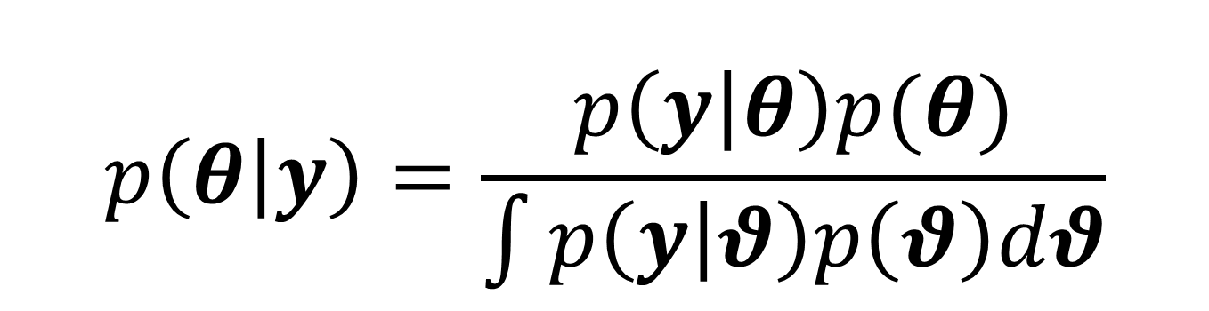
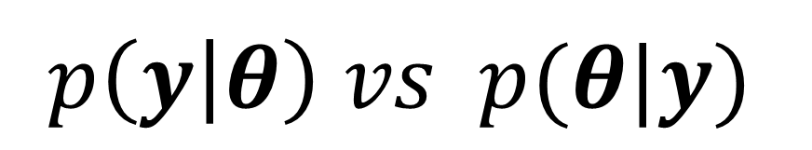
Bayesian
$$p\left(y | θ\right) vs p(θ|y)$$
Posterior distribution vs point estimate
$$p\left(θ | y\right)=\frac{p\left(y | θ\right)p(θ)}{\int{p\left(y | θ\right)p\left(θ\right)dθ}}$$

Slide 18
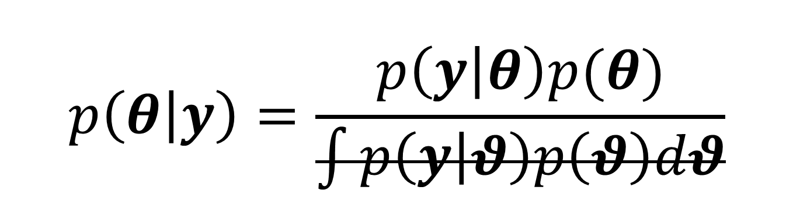
Bayesian
$$p\left(y | θ\right) vs p(θ|y)$$
Posterior distribution vs point estimate
$$p\left(θ | y\right)=\frac{p\left(y | θ\right)p(θ)}{\int{p\left(y | θ\right)p\left(θ\right)dθ}}$$

Slide 19

Bayesian
$$p\left(y | θ\right) vs p(θ|y)$$
Posterior distribution vs point estimate
$$p\left(θ | y\right) \text{∝} p\left(y | θ\right)p(θ)$$
Data likelihood
Prior distribution

Slide 20
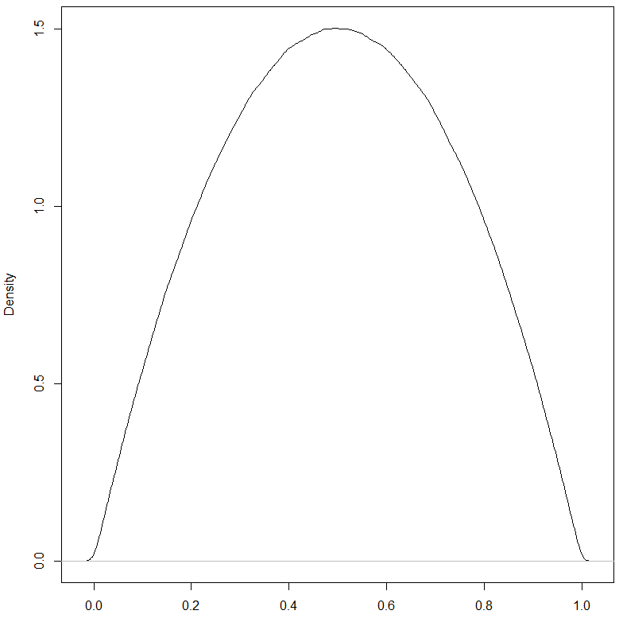

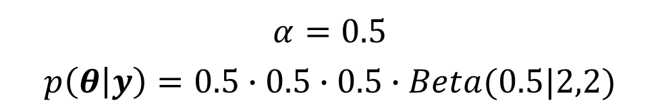


bayesian
Fixed bias
$$\left(\begin{matrix}c_{1} \\ \begin{aligned}c_{2} \\ c_{3}\end{aligned}\end{matrix}\right)=\left(\begin{matrix}L \\ \begin{aligned}R \\ L\end{aligned}\end{matrix}\right)=y$$
$$P\left(y | θ\right)= α∙(1−α)∙α$$
$$P\left(θ\right) \sim Beta(2,2)$$
$$P\left(θ | y\right) \text{∝} α∙\left(1−α\right)∙α∙Beta(α|2,2)$$
$$α=0.5$$
$$p\left(θ | y\right)=0.5∙0.5∙0.5∙Beta(0.5|2,2)$$

Slide 21
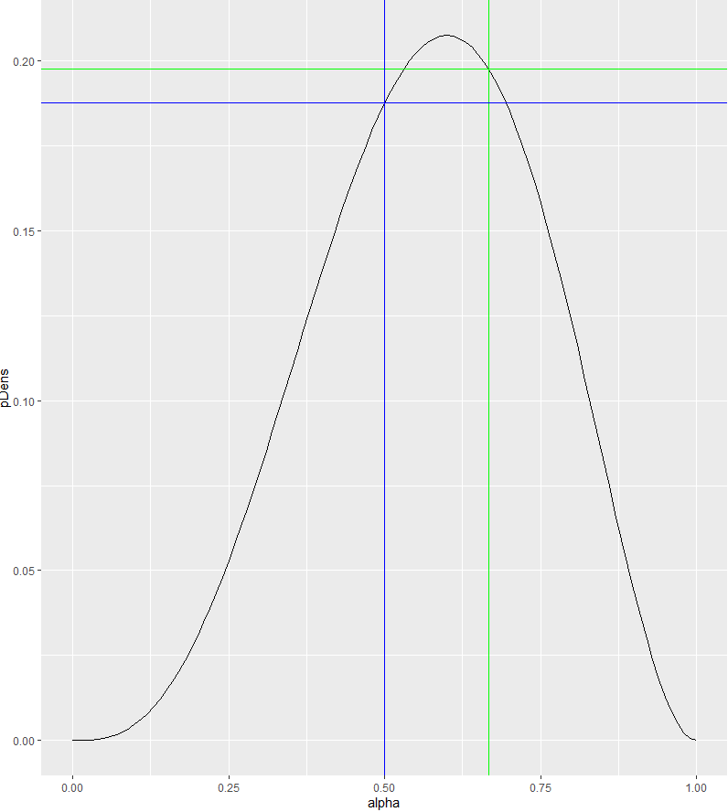
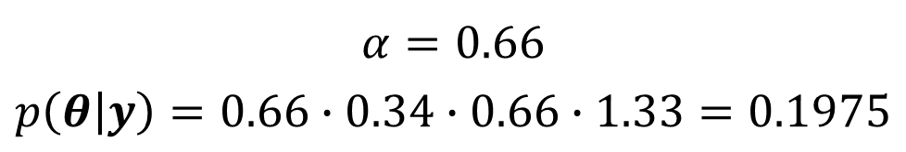
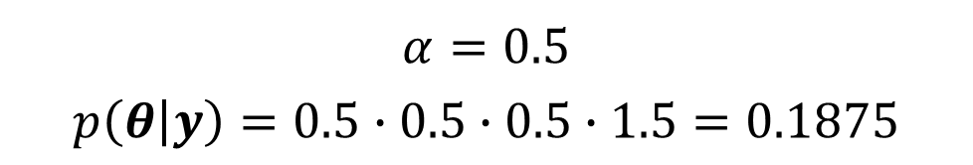
bayesian
Fixed bias
$$\left(\begin{matrix}c_{1} \\ \begin{aligned}c_{2} \\ c_{3}\end{aligned}\end{matrix}\right)=\left(\begin{matrix}L \\ \begin{aligned}R \\ L\end{aligned}\end{matrix}\right)=y$$
$$P\left(y | θ\right)= α∙(1−α)∙α$$
$$P\left(θ\right) \sim Beta(2,2)$$
$$P\left(θ | y\right) \text{∝} α∙\left(1−α\right)∙α∙Beta(α|2,2)$$
$$α=0.5$$
$$p\left(θ | y\right)=0.5∙0.5∙0.5∙1.5=0.1875$$
$$α=0.66$$
$$p\left(θ | y\right)=0.66∙0.34∙0.66∙1.33=0.1975$$

Slide 22
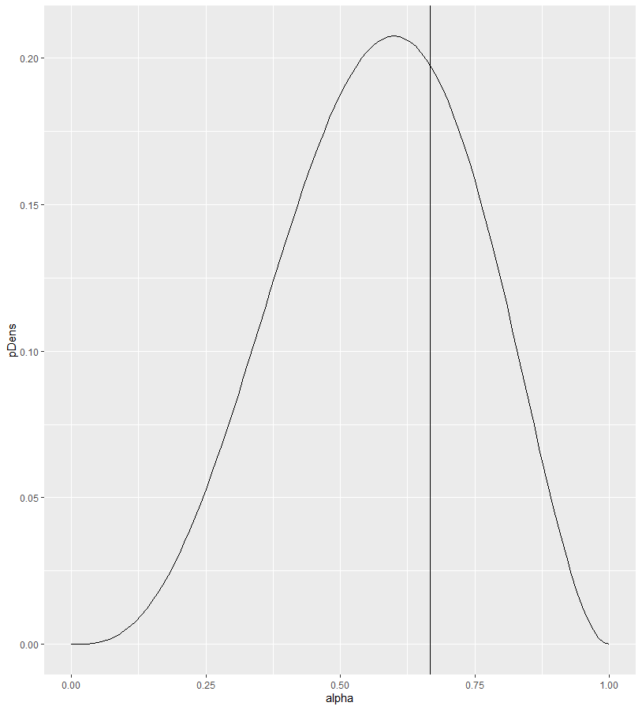
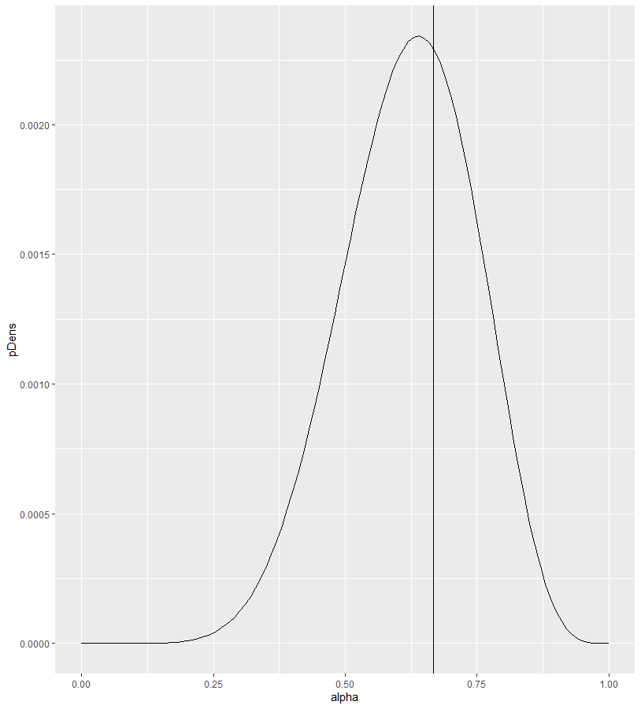
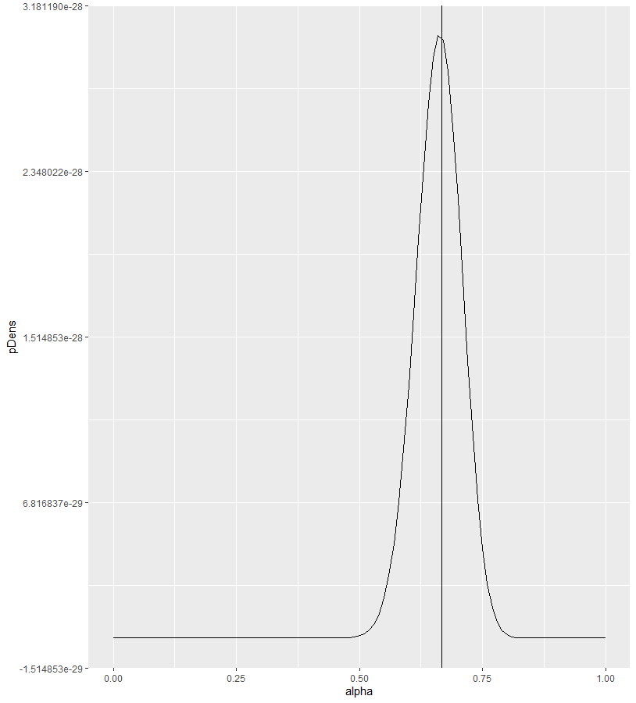

bayesian
Data Matters!
True: $α=0.66, p\left(θ\right)\sim Beta(2,2)$
N = 3
N = 10
N = 100

Slide 23
Bayesian
How to benefit from having multiple participants?
Concatenate data?
What about individual differences?
Hierarchical modeling!

Slide 24


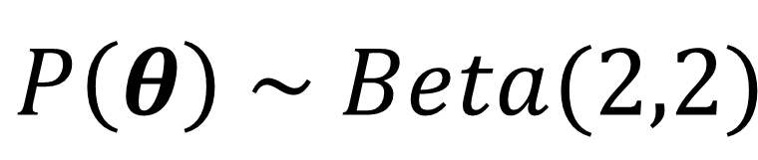
Hierarchical bayesian
Population distribution
$$p\left(θ | y\right) \text{∝} p\left(y | θ\right)p(θ)$$
$$p\text{(}y\text{|}θ\text{) }\sim Bern(y|α)$$
$$P\left(θ\right) \sim Beta(2,2)$$
Fixed population distribution

Slide 25
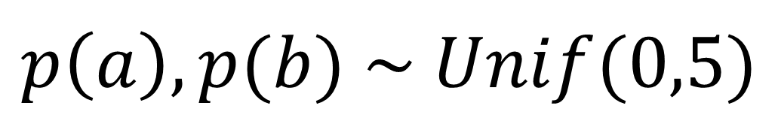
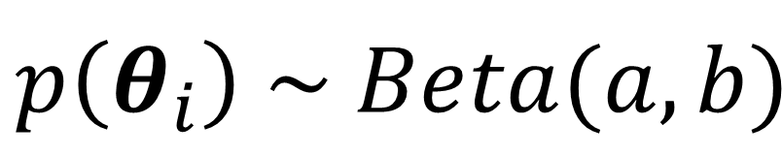


Hierarchical Bayesian
M participants
$$p\left(θ_{i} | y_{i}\right) \text{∝} p\left(y_{i} | θ_{i}\right)p(θ_{i})$$
$$p\text{(}y_{i}\text{|}θ_{i}\text{) }\sim Bern(y_{i}|α_{i})$$
$$p\left(θ_{i}\right) \sim Beta(a,b)$$
$$p\left(a\right),p(b) \sim Unif(0,5)$$

Slide 26
Hierarchical Bayesian
M participants
$$p\left(θ_{i} | y_{i}\right) \text{∝} p\left(y_{i} | θ_{i}\right)p\left(θ_{i}|a,b\right)p\left(a\right)p(b)$$
$$p\text{(}y_{i}\text{|}θ_{i}\text{) }\sim Bern(y_{i}|α_{i})$$
$$p\left(θ_{i}\right) \sim Beta(a,b)$$
$$p\left(a\right),p(b) \sim Unif(0,5)$$

Slide 27
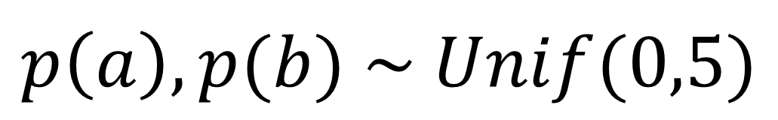
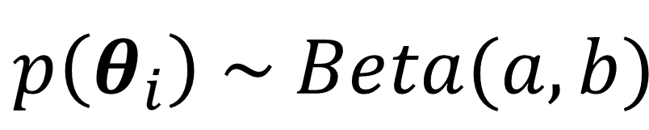

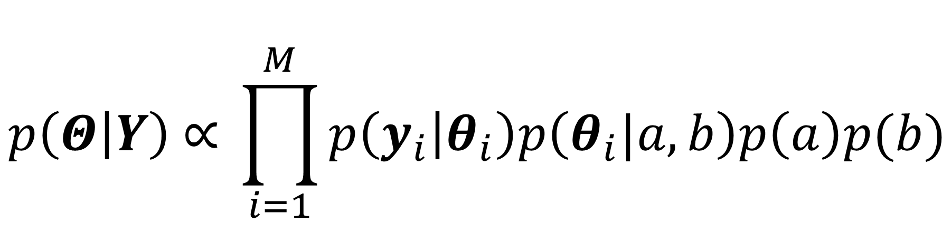
Hierarchical Bayesian
$$p\left(Θ | Y\right) \text{∝} \prod_{i=1}^{M}{p\left(y_{i} | θ_{i}\right)p\left(θ_{i}|a,b\right)p\left(a\right)p(b)}$$
M participants
$$p\text{(}y_{i}\text{|}θ_{i}\text{) }\sim Bern(y_{i}|α_{i})$$
$$p\left(θ_{i}\right) \sim Beta(a,b)$$
$$p\left(a\right),p(b) \sim Unif(0,5)$$

Slide 28
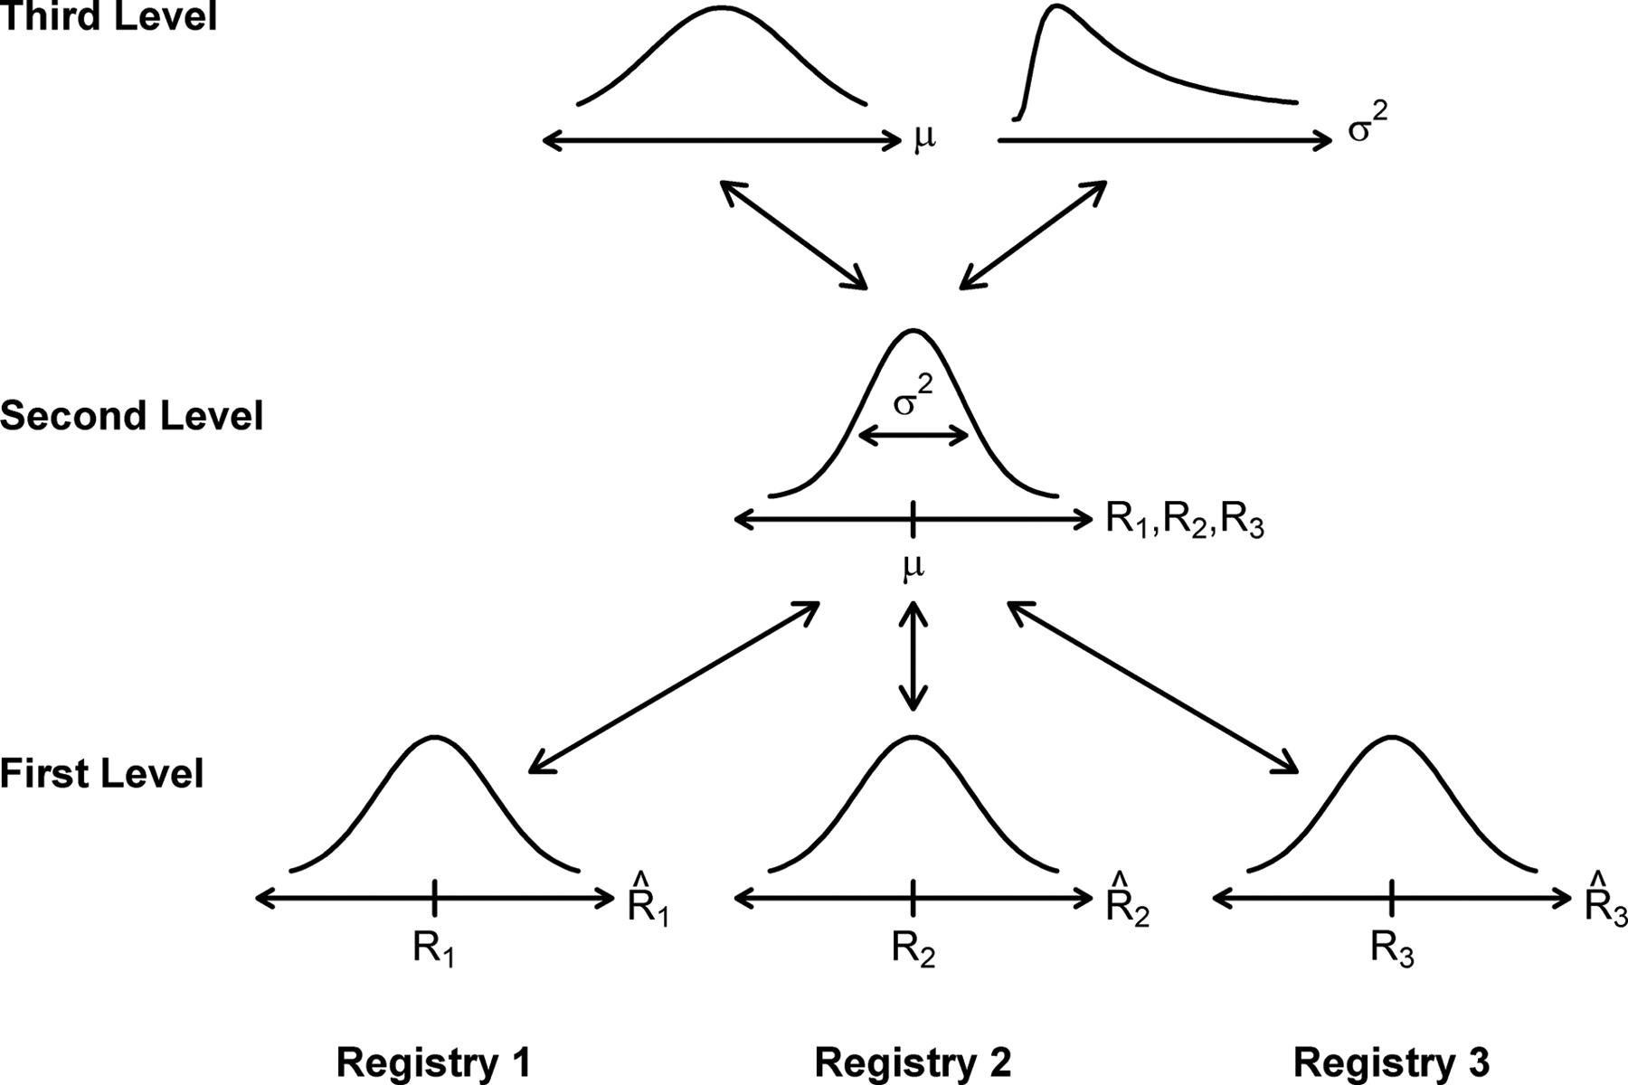
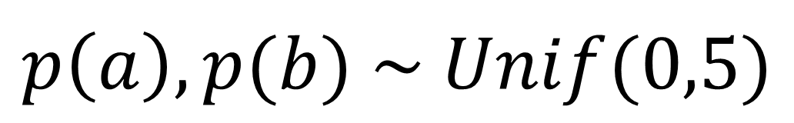

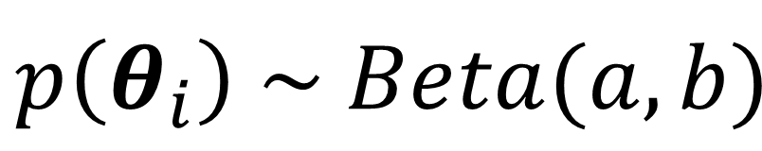
Hierarchical bayesian
$$p\left(a\right),p(b) \sim Unif(0,5)$$
$$p\left(θ_{i}\right) \sim Beta(a,b)$$
$$p\text{(}y_{i}\text{|}θ_{i}\text{) }\sim Bern(y_{i}|α_{i})$$
(L, R, L)
(L, R, R)

Slide 29
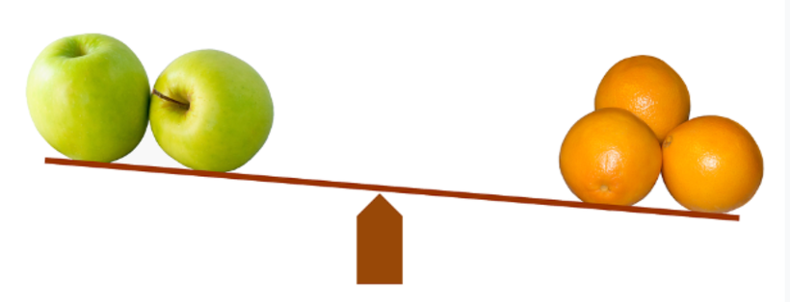
Model Comparison

Slide 30
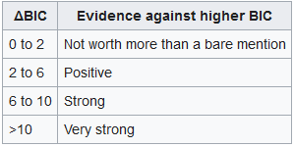
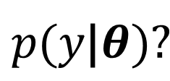
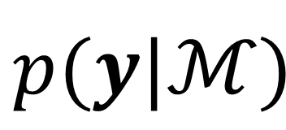
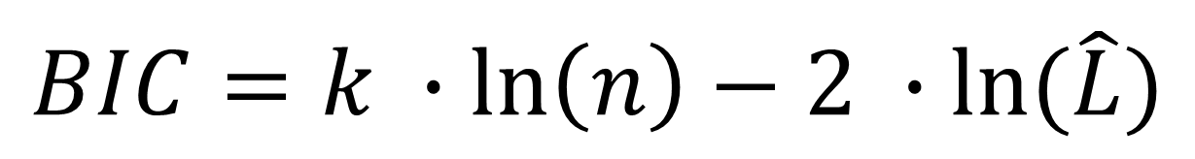
Model evidence
$$p(y|ℳ)$$
$$p\text{(}y\text{|}θ\text{)}\text{?}$$
$$BIC=k ∙\ln\left(n\right)−2 ∙ln⁡(\hat{L})$$
Nr. of parameters
Sample size
RM ANOVA – appropriate!
Stephan et al. (2009)

Slide 31
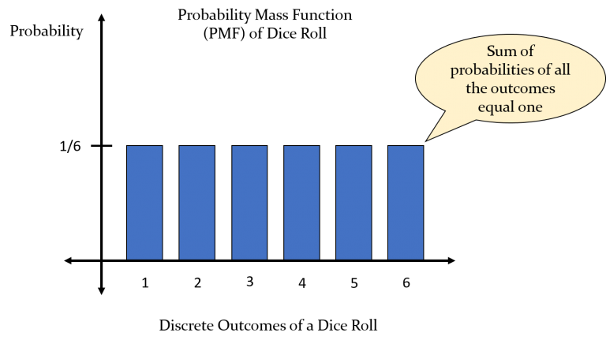


Bayesian model comparison
$$p(ℳ|y)$$
$$\sum_{i}^{K}{p\left(ℳ_{i} | y\right)=\text{1} }$$
Multinomial Distribution
6 parameters r

Slide 32
Bayesian model comparison
$$p(ℳ|y)$$
$$\sum_{i}^{K}{p\left(ℳ_{i} | y\right)=\text{1} }$$
Multinomial Distribution

Slide 33

Multinomial distribution in bayes
$$r=[r_{1},r_{2},…,r_{K}]$$
r₂
r₁

Slide 34


Dirichlet distribution
$$r=[r_{1},r_{2},…,r_{K}]$$
“Simplex”
Dirichlet Distribution

Slide 36



< presenter’s name > < job title > < DEPARTMENT OR RESEARCH GROUP > E <first name>.<surname>@ugent.be T +32 9 000 00 00 M +32 400 00 00 00 www.ugent.be
Universiteit Gent @ugent
@ugent Ghent University

